Slide 1
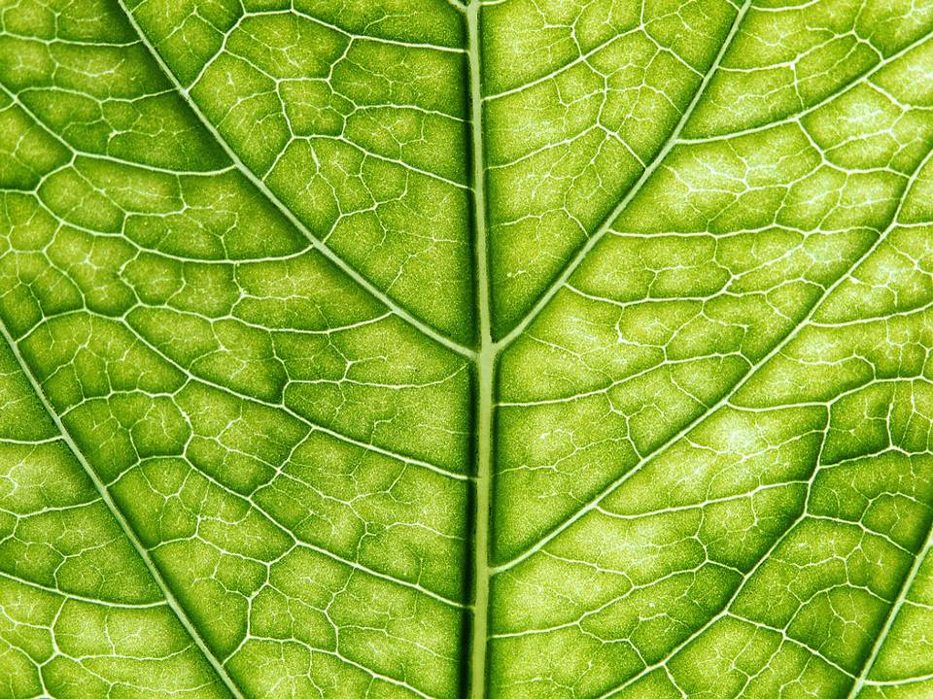
Green Plants

Slide 2

4 Living Processes
Movement- towards light
Reproduction- fruits and seeds
Nutrition- plants make their own food
Growth- seedlings to bigger plants

Slide 3


What do plants need to grow well?
  Sunlight
  Air
  Water
  Warmth
  Minerals

Slide 4
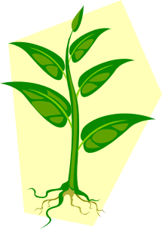



Growing plant
Life Cycle of a Plant
Flowering plant
Germination
Pollination
Dispersal of seeds
Fertilisation

Slide 5
Germination
When a seed starts to grow
Warmth
Air
Water
Root down shoot up Grow leaves
(to find light) (begin making food)

Slide 6

Photosynthesis
Making food using sunlight
Carbon
Dioxide
and
Light
Food
and
Oxygen
Chlorophyll in LEAVES
IN
OUT

Slide 7
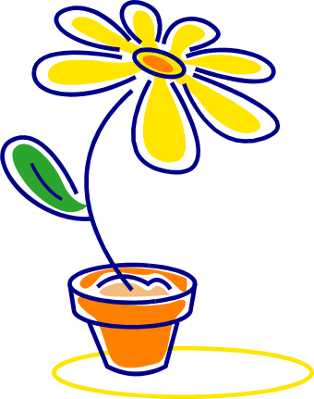
Flowers
Attract insects with their sticky nectar and bright colours
Male part- STAMEN (Anther and filament)
Female part- CARPEL (Stigma, style and ovary)

Slide 8
Pollination
The transfer of pollen onto the stigma
Two ways:
Insect- pollen sticks to the insect and is transferred to the female part (stigma).
Wind- pollen is blown onto the stigma.

Slide 9

Fertilisation
Joining of the pollen and the egg to make a seed.
Pollen travels along the style to reach the carpel where the eggs are stored.
The fertilised egg becomes a seed.

Slide 10
Dispersal of Seeds
Seeds are carried away from the parent plant to stop overcrowding
3 ways:
By wind- dandelion seeds are blown away.
By animals- they eat berries the seeds come out in the poo!
By explosion- seed pods dry up then burst.

